Slide 1



Student Portfolio
Student name : G.saritha
Reg no and NM id: 2428k0233 /asbru4k2428k0233
Department : B.sc Artificial Intelligence And Data
Science
College: College/
University:
Maharani Arts and Science College,Bharathiyar University

Slide 2






Project Title
Student Portfolio

Slide 3




AGENDA
Problem statement
Project overview
End users
Tools and technologies 5.Portfolio design and layout
Features and functionality
Result and screenshots 8.Conclusion

Slide 4






Problem Statement
Many students face challenges in showcasing their skills, projects, and achievements in a structured way. Without a proper platform, their talents often remain unnoticed. A personal portfolio website solves this problem by providing a digital space to present academic work, technical skills, and creative projects. This helps in building a professional identity and improving career or academic opportunities.

Slide 5



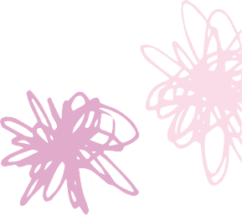


Project Overview
The student portfolio is a personalized website designed to highlight academic achievements, technical skills, and creative projects. It provides a well-organized platform to present personal details, educational background, and project work. The portfolio also includes interactive features like images, links, and a contact section. Overall, it serves as a digital resume that reflects both professionalism and individuality.

Slide 6


End Users
The end users of a student portfolio include teachers and professors who assess academic growth. Recruiters and employers use it to evaluate skills and projects for career opportunities. Peers and classmates may also view it for collaboration and inspiration. Additionally, mentors and institutions can use it to track overall development.

Slide 7


Tools and Technologies
The student portfolio is developed using HTML for structure, CSS for styling, and JavaScript for interactivity. It may also include frameworks like Bootstrap or Tailwind CSS for responsive design.
For hosting, platforms such as GitHub Pages or Netlify can be used. Additionally, tools like Canva or Photoshop help in creating visuals and graphics

Slide 8
Portfolio Design And Layout
The student portfolio is designed with a clean and simple layout for easy navigation. It includes sections like home, about, education, skills, projects, and contact. Visual elements such as images, icons, and colors make it attractive and engaging. The responsive design ensures it works well on both computers and mobile devices.

Slide 9




Features And Functionality
The student portfolio highlights personal details, skills, and academic achievements in an organized way. It allows showcasing projects with descriptions, images, and links. A contact section enables easy communication with teachers, peers, or recruiters. The portfolio is interactive, user-friendly, and accessible on different devices.

Slide 10



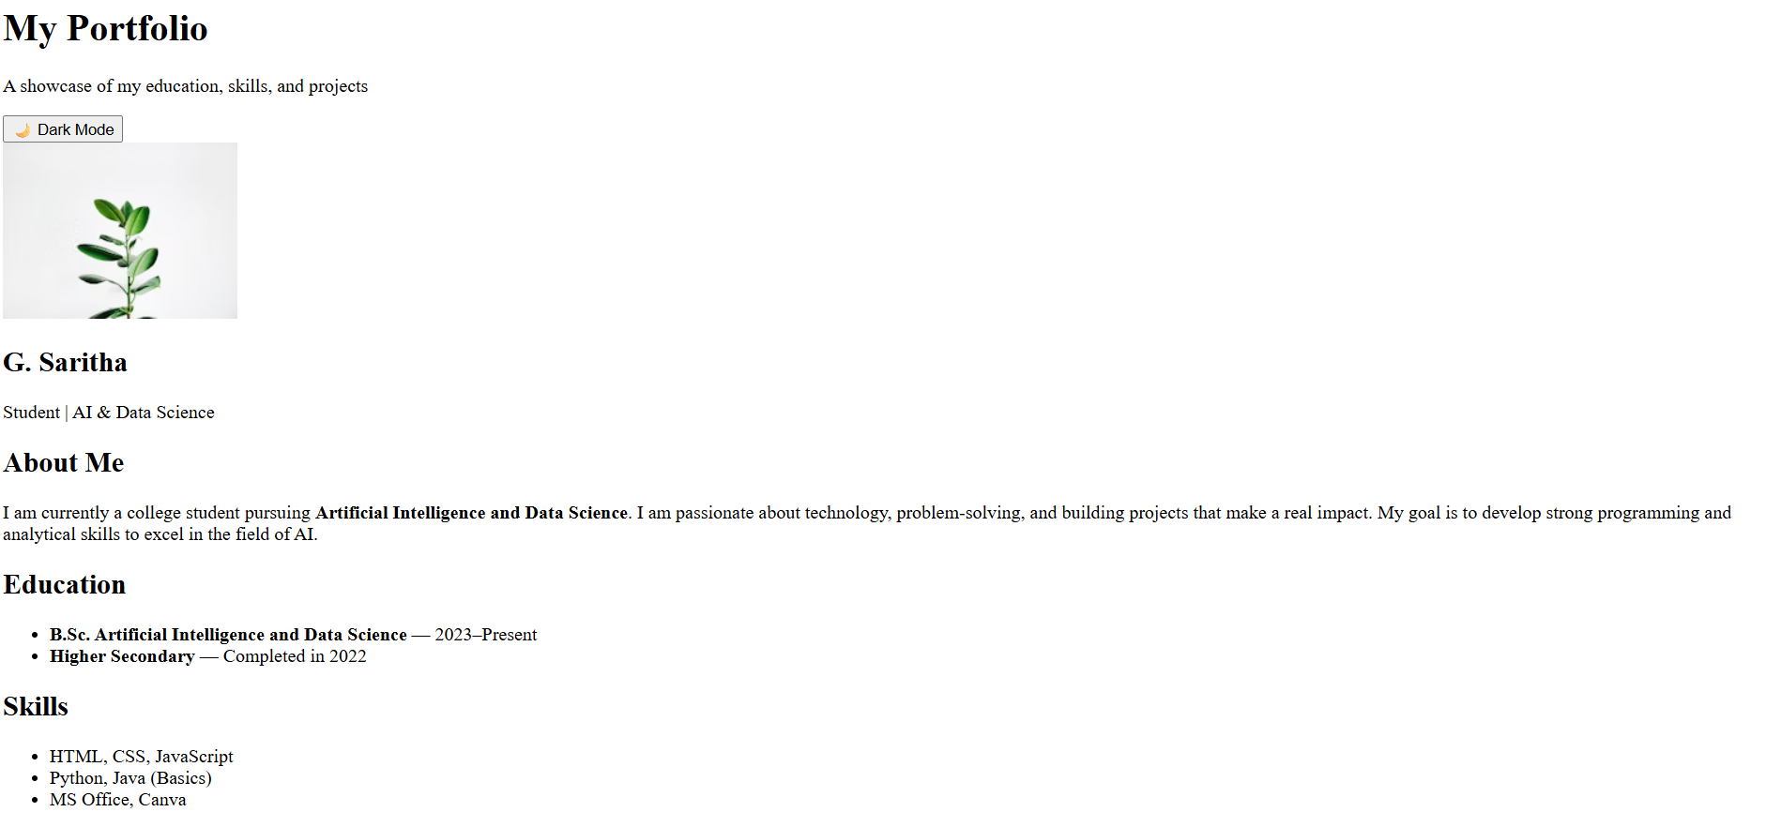
Result And Screenshots

Slide 11
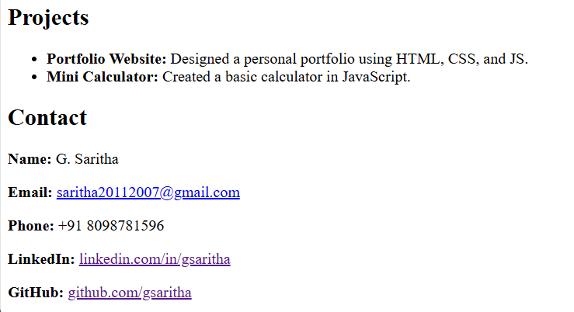
Result And Screenshots

Slide 12


Conclusion
The student portfolio serves as a digital platform to showcase academic achievements, skills, and projects. It helps in building a professional identity and creates a positive impression. The portfolio is easy to use, visually appealing, and accessible on multiple devices. Overall, it is an effective tool for both academic and career opportunities

Slide 13



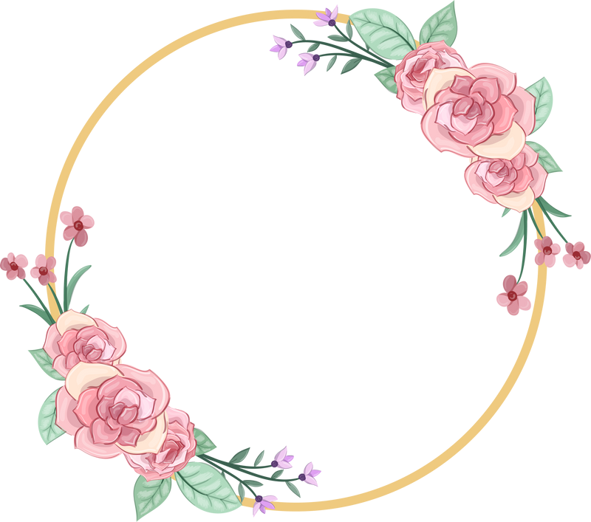


Thank You

